Slide 1
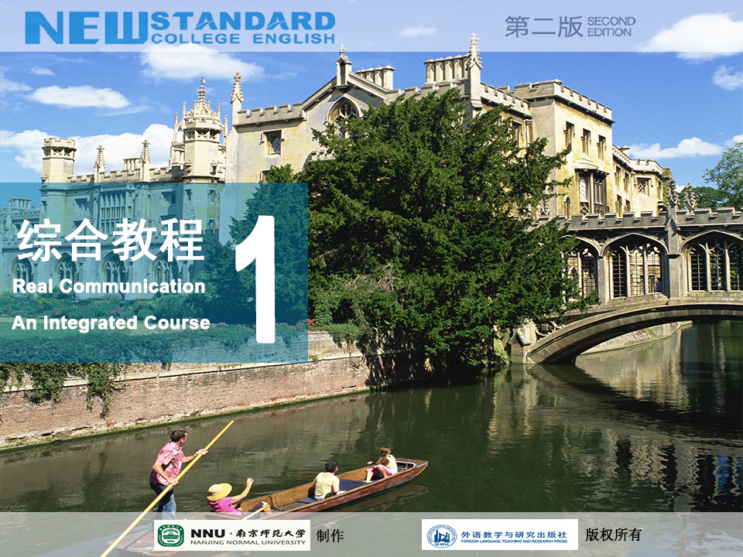

Slide 2

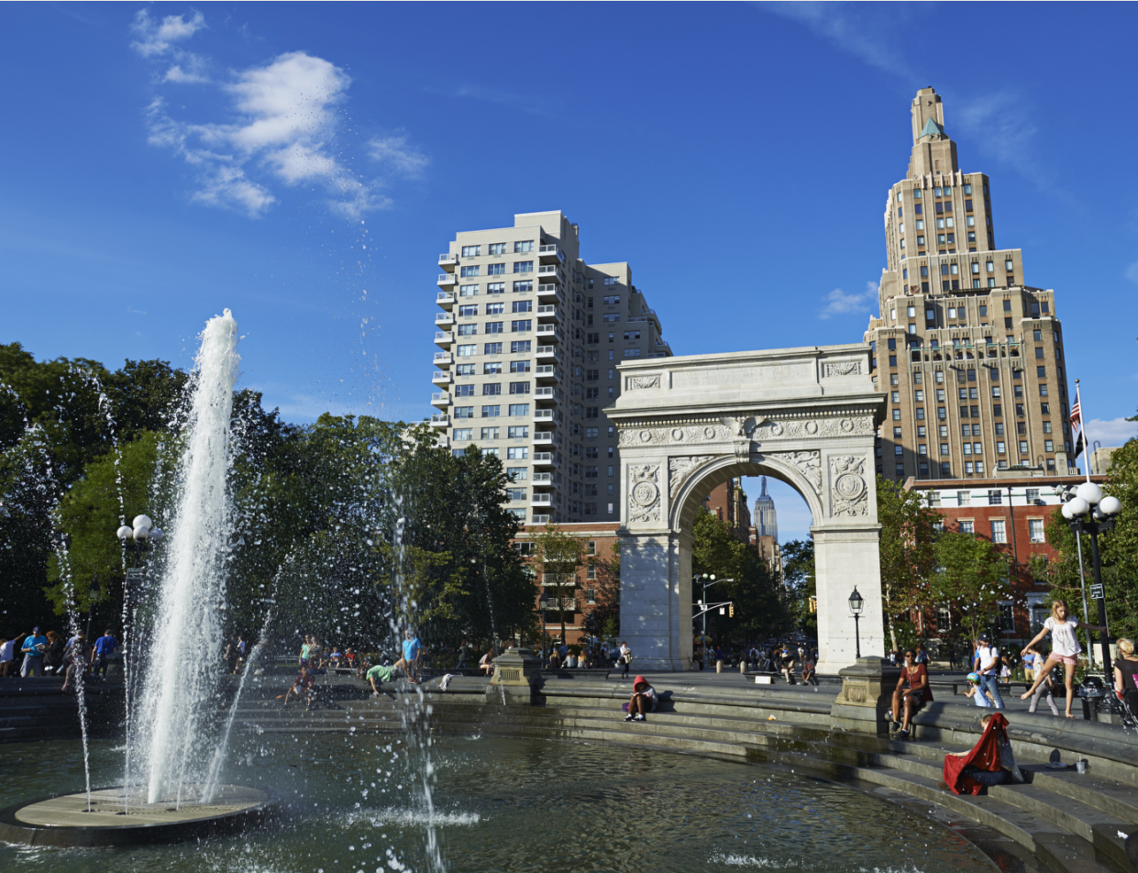






Contents
Active Reading 2

Slide 3


Warming Up
Watching & discussing
About the author
About the text

Slide 4



Warming Up
Watch the video clip. Suppose you were one of the students in the class, follow the teacher’s questions and give your reasons.
1. In the first case, what would you do and why?
2. In the second case, what would you do and why?

Slide 5

Warming Up
Think about the class in the video.
Discuss in pairs about the differences between a high school class and a college class.
What is the most difficult part for you in a college class?

Slide 6
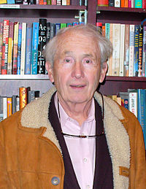
Warming Up
About the Author
Frank McCourt (August 19, 1930 – July 19, 2009)

Slide 7

Warming Up
Frank McCourt was born in Brooklyn (布鲁克林区), New York, to Irish immigrant parents. Unable to find work in the depths of the Depression (美国经济大萧条), the McCourts returned to the mother’s native Limerick, Ireland, where they sunk deeper into the poverty McCourt describes so movingly in his memoir, Angela's Ashes (1996).

Slide 8

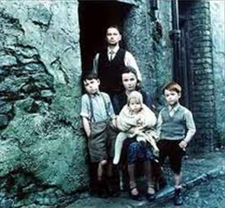
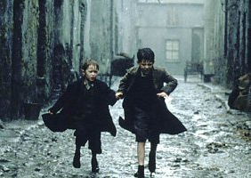
Warming Up
“When I look back on my childhood I wonder how I managed to survive at all. It was, of course, a miserable childhood: The happy childhood is hardly worth your while. Worse than the ordinary miserable childhood is the miserable Irish childhood, and worse yet is the miserable Irish Catholic childhood.” So begins the memoir of Frank McCourt.

Slide 9
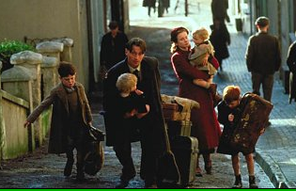
Warming Up
Frank’s mother, Angela, has no money to feed the children since Frank’s father, an alcoholic, rarely works, and when he does he drinks his wages. He eventually abandoned the family altogether. Three of the seven children died of diseases. Frank endures poverty, near-starvation (饿死) and the casual cruelty of relatives and neighbours.

Slide 10
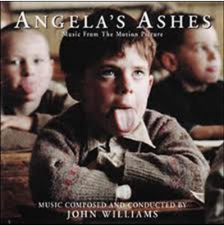
Warming Up
Yet Father does nurture (培养) in Frank an appetite for the one thing he can provide: a story. Frank lives for his father’s tales. Perhaps it is story that explains Frank’s survival. Despite the horrors of McCourt’s childhood, he told his story with humour, brilliant description, and deep compassion for his family, even for the father who gave him a love of language and storytelling.

Slide 11

Warming Up
About the text
’Tis: A Memoir is the sequel (续篇) to Angela’s Ashes which continues McCourt’s life journey after his return to New York in 1949 with his “pimply (长粉刺的) face, sore eyes, and bad teeth”. Friendless and clueless about American customs, he struggled to integrate himself into American blue-collar society.

Slide 12
Warming Up
He had little in common with the healthy, self-assured (自信的) college students he saw on the subway and dreamed of joining in the classroom. Initially, his American experience was as upsetting as his poor youth in Ireland. McCourt viewed the US through the same sharp eye and with the same dark humour that distinguished his first memoir.

Slide 13
Warming Up
’Tis: A Memoir examines Frank’s relationship to his family and his wife during this time (all his siblings and his mother move to America over the course of the book). Frank’s mother, Angela McCourt, was in increasingly bad health and died in New York around the same time as Frank’s father died in Ireland. Frank went to Ireland to bury his father and scattered his mother’s ashes. The book ends after Frank and his brothers scatter Angela’s ashes over the graves of her family.

Slide 14

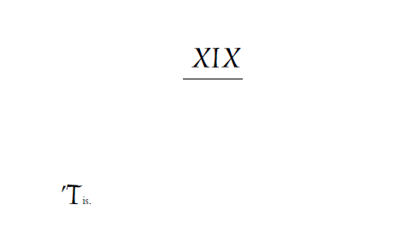
Warming Up
'Tis was the final and only word of the last chapter of Angela’s Ashes, while 'Tis ends with the spreading of Angela McCourt’s ashes in Ireland.
Frank McCourt followed this book with another memoir, Teacher Man.

Slide 15
Warming Up
About the Text
What is the change in the writer’s full-time working life?
He has been allowed to take two courses in NYU.
He feels very happy even proud of being a NYU student.
How does the writer feel?
He is not very satisfied with the two courses.

Slide 16

Text
Extract from ’Tis: A Memoir

Slide 17

Text
Extract from ’Tis: A Memoir
1 Since I’m not a high school graduate and work full time, I’m allowed to take only two courses, Introduction to Literature and The History of Education in America. I don’t know why I have to be introduced to literature but the woman in the admissions office says it’s a requirement even though I’ve read Dostoyevsky and Melville and that’s admirable for someone without a high school education. She says The History of Education in America course will provide me with the broad cultural background I need after my inadequate European education.

Slide 18
Text
2 I’m in heaven and the first thing to do is buy the required textbooks, cover them with the purple and white NYU book jackets so that people in the subway will look at me admiringly.
3 All I know of university classes is what I saw a long time ago in the movies in Limerick and here I am sitting in one, The History of Education in America, with Professor Maxine Green up there on the platform telling us how the Pilgrims educated their children.

Slide 19
Text
All around me are students scribbling away in their notebooks and I wish I knew what to scribble myself. How am I supposed to know what’s important out of all the things she’s saying up there? Am I supposed to remember everything? Some students raise their hands to ask questions but I could never do that. The whole class would stare at me and wonder who’s the one with the accent. I could try an American accent but that never works. When I try it people always smile and say, Do I detect an Irish brogue?

Slide 20
Text
4 The professor is saying the Pilgrims left England to escape religious persecution and that puzzles me because the Pilgrims were English themselves and the English were always the ones who persecuted everyone else, especially the Irish. I’d like to raise my hand and tell the professor how the Irish suffered for centuries under English rule but I’m sure everyone in this class has a high school diploma and if I open my mouth they’ll know I’m not one of them.
5 Other students are easy about raising their hands and they always say, Well, I think.

Slide 21
Text
6 Some day I’ll raise my hand and say, Well, I think, but I don’t know what to think about Pilgrims and their education. Then the professor tells us ideas don’t drop fully formed from the skies, that the Pilgrims were, in the long run, children of the Reformation with an accompanying world view and their attitudes to children were so informed.
7 There is more notebook scribbling around the room, the women busier than the men. The women scribble as if every word out of Professor Green’s mouth were important.

Slide 22
Text
8 Then I wonder why I have this fat textbook on American education which I carry in subways so that people can admire me for being a college student. I know there will be examinations, a mid-term and a final, but where will the questions come from? If the professor talks and talks and the textbook is 700 pages I’ll surely be lost.

Slide 23
Text
9 There are good-looking girls in the class and I’d like to ask one if she knows what I should know before the mid-term exam in seven weeks. I’d like to go to the university cafeteria or a Greenwich Village coffee shop and chat with the girl about the Pilgrims and their Puritan ways and how they frightened the life out of their children. I could tell the girl how I read Dostoyevsky and Melville and she’d be impressed and fall in love with me and we’d study the history of education in America together.
■

Slide 24

Text
《回忆录》（节选）
1 由于我不是高中毕业生，而且有一份全职工作，所以他们只允许我选修两门课程：“文学概论”和“美国教育史”。我不知道为什么我非得了解文学。可是招生办公室的那位女士说，虽然我读过陀思妥耶夫斯基和梅尔维尔的小说，虽然一个没上过高中的人能读这些书的确令人敬佩，但这门课是必修课。她说由于我接受的欧洲教育不全面，“美国教育史”能使我具备广博的文化背景知识。

Slide 25
Text
2 我乐得飘飘然了，第一件事就是去买所需要的课本，然后用纽约大学紫白相间的护封把它们套起来，这样地铁里的乘客就会向我投来艳羡的目光了。
3 我对大学课堂的了解全部来自很久以前我在利默里克看的那些电影，我现在就坐在大学课堂里听一门课——“美国教育史”。玛克辛·格林教授在讲台上给我们讲移居美国的英国清教徒是如何教育他们的下一代的。

Slide 26
Text
我周围的同学全都在不停地记笔记。我真希望自己也知道记点儿什么。我怎么知道她在讲台上说的哪些话是重要的呢？她说的每一句话我都要记住吗？有些同学举手问问题，可我永远不能那么做，因为全班同学都会盯着我，不知道那个说话带口音的家伙究竟是谁。我可以尝试用美国口音说话，可是却说得并不地道。我试着用美音说话时，人们总是微笑着说，是不是听到爱尔兰土腔了？

Slide 27
Text
4 教授说清教徒离开英国是为了逃避宗教迫害，这让我大惑不解，因为清教徒本身就是英国人，而英国人总是到处迫害别人，尤其是爱尔兰人。我真想举手告诉教授爱尔兰人几百年来在英国的统治下所遭受的痛苦，但我知道班上的每个人都有高中文凭，只要我一开口，他们就会知道我和他们不一样。
5 其他同学都从容自信地举手发言。他们总是说：嗯，我认为……

Slide 28
Text
6 总有一天我也会举手发言，说：嗯，我认为……可对清教徒和他们的教育问题，我还真不知道该如何认为。接着，教授告诉我们，观念并不是从天而降的现成品。从长远来看，清教徒是宗教改革运动的产物，他们继承了宗教改革运动的世界观，并且他们对孩子的态度也由此体现了宗教改革运动的思想。
7 教室里记笔记的沙沙声更响了，女生比男生更忙活。女生们不停地记，就好像从格林教授嘴里说出的每个字都很重要似的。

Slide 29
Text
8 接下来我开始琢磨，为什么我要买这本厚厚的《美国教育史》呢？为什么我要带着它坐地铁，好让大家都羡慕我是个大学生呢？我知道会有考试，有期中考试，有期末考试，可是考试题会从哪里出呢？如果教授不停地讲啊讲，而课本又有 700 页之多的话，到时候我肯定会不知所措的。

Slide 30
Text
9 班上有的女生漂亮迷人，我想问问其中的一个她是否知道我该掌握什么内容以应付七周后的期中考试。我愿意和她一起去学校的自助餐厅或是格林尼治村的咖啡馆，一块儿谈谈清教徒和他们极端拘谨的生活方式，谈谈他们是怎么把孩子吓破胆的。我可以告诉那名女生我是如何读陀思妥耶夫斯基和梅尔维尔的小说的。说不定她会被我打动，继而爱上我，然后我们一起研读美国教育史。

Slide 31

Words & Phrases
’tis
admiringly
persecution
memoir
pilgrim
persecute
admirable
scribble
diploma
cultural
detect
surely
inadequate
Irish
cafeteria
subway
brogue
Puritan
out of
in the long run
be / feel lost
frighten the life out of sb / frighten sb to death

Slide 32
Words & Phrases
Dostoyevsky 陀思妥耶夫斯基
Melville 梅尔维尔
NYU (New York University) 纽约大学
Limerick 利默里克（爱尔兰西部城市）
Maxine Green 玛克辛·格林（人名）
the Reformation （欧洲16世纪的）宗教改革
Greenwich Village 格林尼治村

Slide 33
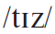

Words & Phrases
’tis (literary) it is 它是
e.g.
1. ’Tis wise to learn; ’tis God-like to create.
—J. G. Saxe
明智的了解到；这是如神的创造。
——J. G.·萨克逊
2. Ay – that I will drink; ’tis my only doctor.
好啊，我会喝的；这是唯一的灵丹妙药。

Slide 34
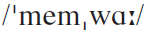
Words & Phrases
memoir n.
1. (~s) an account of sb.’s experiences written by that person, especially the experiences of sb. who has taken part in important political or military events 见闻录；回忆录
e.g. Lady Thatcher had just published her memoirs.
撒切尔夫人刚出版了回忆录。
2. [C] a written account of the life of sb. you knew well 传略；实录
e.g. She wrote a memoir of her stay in France.
她写了一篇旅法实录。

Slide 35
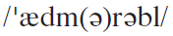
Words & Phrases
admirable a. deserving to be admired or respected 令人赞赏的；令人钦佩的
Word family:
admirably ad.
admire vt. not in progressive 不用进行式
admiration n.
admiring a. = appreciative
admirer n.
See also: admiringly ad.

Slide 36
Words & Phrases
Fill in the blanks with proper words:
admirable admire admiring admiration admirer
1. Much as I __________ David as a poet, I do not like him as a man. (CET4-2003-12)
2. His handling of the situation was __________.
3. Miss White received a bunch of flowers from her _________.
4. They looked in silent __________ at the painting.
5. She gave me one of her rare _________ looks.
admire
作为一位诗人，大卫令我钦佩；但作为一个男人，我并不喜欢他。
admirable
他对这情况的处理令人钦佩 。
admirer
怀特小姐收到爱慕者所送的一束花。
admiration
他们默默地欣赏着那幅画 。
admiring
她投给我罕见的赞赏的目光。

Slide 37
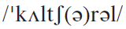
Words & Phrases
cultural a.
1. relating to the culture of a particular group, country, or society 文化（上）的
e.g. Many people suffered from cultural shock when they came abroad.
许多人到国外时，都感受到文化震撼。
2. relating to music, literature, and other arts （音乐、文学等）文化艺术的
e.g. In the later Middle Ages, Prague was an important cultural centre.
中世纪后期，布拉格是一个重要的文化中心。

Slide 38
Words & Phrases
Work in pairs and translate the following into Chinese.
KFC, Starbucks, McDonalds and other cultural invasions
肯德基、星巴克、麦当劳及其他文化侵略
mass cultural products
unearthed cultural relics
大众文化产品
出土文物
cultural nationalism in the process of globalization
全球化进程中的文化民族主义

Slide 39
Words & Phrases
international business and cross-cultural communication
国际贸易和跨文化交流
a multicultural society
多元社会
the cultural diversity of the United States
美国的文化多样性
cultural legacies of the Renaissance
文艺复兴时期的文化遗产

Slide 40
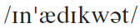
Words & Phrases
inadequate a. not enough or not good enough for a particular purpose 不充分的；不够格的；不适当的
e.g.
1. The safety precautions are totally inadequate.
这些安全措施完全不合格。
2. He always feels inadequate when faced by a difficult problem.
他面对难题总觉得力不从心。
Antonym: adequate

Slide 41
Words & Phrases
Word family:
inadequately ad.
inadequacy n.
in-, il-, im-, ir-
在某些形容词之前表示否定、相反或缺乏之意
inadequate →
adequate
e.g. inattentive →
illogical →
attentive
impure →
irregular →
pure
logical
regular
Complete the sentences on the next page with the correct form of the words in the box.

Slide 42
Words & Phrases
1. She had received no aid from education: She was ignorant and __________.
2. With her beauty, wit and charm, he found her __________.
3. By law, when one makes a large purchase, he should have __________ opportunity to change his mind. (CET4-2000-6-29)
4. As well as being precise, the report being delivered was __________.
5. He earns an __________ amount of money.
inadequate credible illiterate resistible personal
illiterate
她没能得到教育的帮助，蒙昧无知。
irresistible
她漂亮、聪明、有魅力，他不由得一见倾心。
adequate
法律规定，当进行较大金额的购买活动时，购买者应有充分机会改变决定。
impersonal
这篇稿子不仅用词确切，而且不带个人色彩。
incredible
他挣的钱多得惊人。

Slide 43
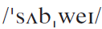
Words & Phrases
subway n. [C]
1. (AmE) a railway that runs under the ground (BrE underground) （美）地铁
e.g.
1. The subway in New York can be a bit confusing for first-time visitors.
对于第一次去纽约的人来说，那里的地铁有点儿让人摸不着头脑。
2. He bought some tokens for the subway.
他买了一些乘地铁用的代用币。
2. (BrE) a path for people to walk under a road or railway （英）（公路或铁路下的）地下通道 / 人行道
e.g. Use the short subway beneath the highway for walking to the beach.
走公路底下的短途地下通道到海滨去。

Slide 44
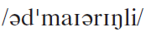
Words & Phrases
admiringly ad. in a way that shows you think sb. or sth. is very impressive or attractive 钦佩地；赞赏地；羡慕地
e.g.
1. A moment later he says admiringly, “that tracking system is amazing.”
过了一会儿，他赞叹道，“那个跟踪系统真了不起。”
2. She turned to gaze admiringly at her husband.
她转过身来赞赏地凝视着她的丈夫。
See also: admirable

Slide 45
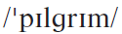
Words & Phrases
pilgrim n. [C]
1. (Pilgrim) one of the people who left England and went to live in what is now the US in the early 17th century（17世纪早期离开英国到了如今的美国的）清教徒移民
e.g. I wanted to know how the Pilgrims educated their children.
我想知道移居美国的英国清教徒是如何教育他们的下一代的。
2. sb. who travels to a holy place that is important in their religion 朝圣者；香客
e.g. pilgrims at Jerusalem
耶路撒冷的朝圣者

Slide 46
Words & Phrases
The Pilgrims were Protestant Christians who left England in the early 17th century because their religious beliefs were not being respected. They went to live in Massachusetts on the east coast of America, and established the first English settlement of what is now the United States. Today, the term Pilgrim Fathers is often used to describe the founders of the American colonies.

Slide 47
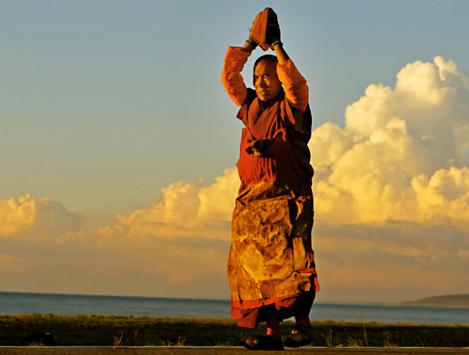
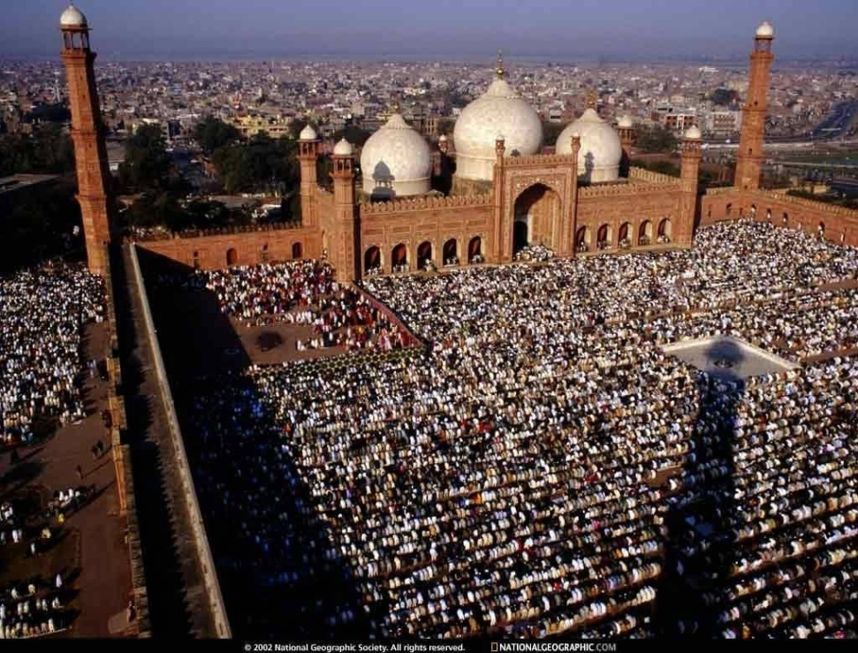
Words & Phrases
pilgrims at Jerusalem
耶路撒冷的朝圣者
Word family:
pilgrimage 朝圣之旅
Pilgrimage to Mecca 麦加朝圣

Slide 48
Words & Phrases
scribble v.
1. to write sth. quickly and carelessly, especially because you do not have much time 草草记下，匆匆书写（尤指因时间仓促）
e.g. She scribbled her apartment phone number on the back of a business card.
她在一张名片的反面匆匆写下了她公寓的电话号码。
2. to make marks or drawings with no meaning 乱涂；涂写； 乱画
e.g. When Caroline was five she scribbled on a wall.
卡罗琳五岁的时候喜欢在墙上乱画。
3. n. marks and drawings with no meaning 涂鸦；潦草的写法
e.g. 1. scribbles all over the page
2. an illegible scribble
纸上的涂鸦
不易辨认的潦草字迹

Slide 49
Words & Phrases
It may help to understand and remember the word scribble if we relate it to a set of words: scribe (to write, or a writer), a scribbler (an unimportant writer), a script (the manuscript of a play or movie, or a system of writing a language, like Arabic script), a manuscript (a document originally written by hand), PS or postscript (an extra message written after one has signed a letter). This illustrates a productive vocabulary learning strategy of linking morphologically (形态学上地) related words together in sets.

Slide 50
Words & Phrases
Fill in the blanks with proper words.
1. I should like to add a _________ to your letter for John Cage.
2. The _______ worked hard to support his family.
3. I have to declare that I am not a ________ of no reputation, and that I possess much natural eloquence.
4. James Cameron wrote the _______ and directed both films.
5. I am grateful to him for letting me read his early chapters in __________.
scribbler postscript script manuscript scribe
postscript
scribe
scribbler
scripts
manuscript

Slide 51
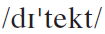
Words & Phrases
detect vt.
1. notice sth., especially when it is not obvious 察觉，发觉，发现（尤指不明显的事）
e.g. If you read between the lines, you can detect a certain sadness.
在字里行间，你可以看出他的忧伤。
2. prove that sth. is present using scientific methods 查出；测出
e.g. Many forms of cancer can be cured if detected early.
如果发现得早，许多癌症都是可以治愈的。
Word family: detection n. detective n.
e.g. a detective novel
侦探小说

Slide 52
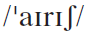
Words & Phrases
Irish a.
1. relating to Ireland, or its language or culture 爱尔兰的；爱尔兰语的；爱尔兰文化的
e.g. He played an old Irish melody.
他演奏了一支古老的爱尔兰曲调。
2. (of sb.) from Ireland 爱尔兰人的
e.g.
1. The Irish themselves, it must be admitted, contributed to this final division.
必须承认，爱尔兰人自己也促成了这种最后的分裂。
2. He comes from a family of Irish extraction.
他出身于一个有爱尔兰血统的家庭。

Slide 53
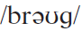
Words & Phrases
brogue n. [sing] a strong local accent, especially an Irish or Scottish accent 土腔，地方腔（尤指爱尔兰腔或苏格兰腔）
A brogue is a strong local accent, especially an Irish or a Scottish accent. Accent and brogue both refer to pronunciation features. Accent is a more general term. Brogue emphasizes the locality of the accent, particularly referring to an Irish or a Scottish accent. For example, the common expression an Irish brogue means the person has a strong Irish accent.

Slide 54
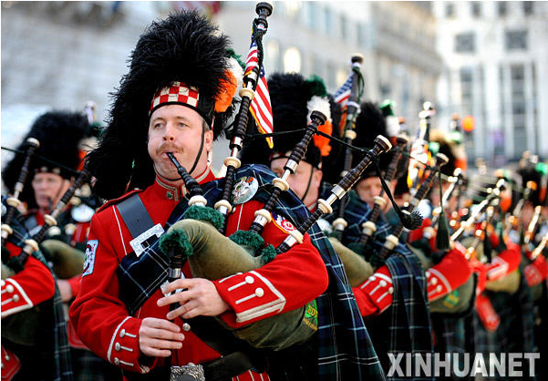
Words & Phrases
e.g.
1. Gill speaks in a quiet Irish brogue.
吉尔讲话声音比较轻，带有爱尔兰口音。
2. His grandfather spoke with a thick Scottish brogue.
他的祖父说话带有很重的苏格兰土腔。

Slide 55
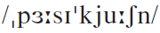
Words & Phrases
persecution n. [C, U] extremely bad treatment of sb., especially because of their race, religion, or political beliefs（尤指因种族、宗教或政治信仰而进行的）迫害，残害
e.g.
1. The heretic met with severe persecution.
那个异教徒遭到残酷迫害。
2. Charlie become the victim of this persecution.
查理成为这次迫害的牺牲品。
Word family: persecute v.
persecutor n. 迫害（他人）者

Slide 56
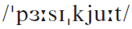
Words & Phrases
persecute vt. treat sb. extremely badly or refuse them equal rights, especially because of their race, religion, or political beliefs（尤指因种族、宗教或政治信仰而）迫害，残害
e.g.
1. Puritans left England to escape being persecuted.
为躲避迫害，清教徒离开了英国。
2. The country’s leaders relentlessly persecuted those who fought against the regime.
该国的掌权者们无休止地迫害那些反抗政权的人们。
Word family: persecution n.
persecutor n. 迫害（他人）者

Slide 57
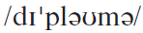
Words & Phrases
diploma n. [C]
1. (AmE) a document showing that a student has successfully completed their high school or university education 毕业文凭；学位证书
e.g. a high school / bachelor’s / master’s / doctor’s diploma
高中 / 学士/硕士/博士文凭
2. (BrE) a document showing that sb. has successfully completed a course of study or passed an examination 结业证书；执照
e.g.
1. I’m hoping to get my teaching diploma this year.
我希望今年能拿到教师证书。
2. He has got a diploma in social work.
他已经获得从事社会工作的资格证书。

Slide 58
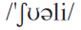
Words & Phrases
surely ad.
1. without any doubt 无疑；肯定
e.g. This will surely cause problems.
这肯定会出问题的。
2. used for showing that you believe sth. is very likely（用于表明你相信某事极有可能）想必，谅必
e.g.
1. You must have heard about the riots surely?
想必你已经听到发生骚乱的事了吧？
2. Surely she didn’t mean it – it was just a thoughtless remark.
想必她不是当真的——这只是欠考虑的言辞而已。

Slide 59
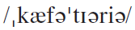
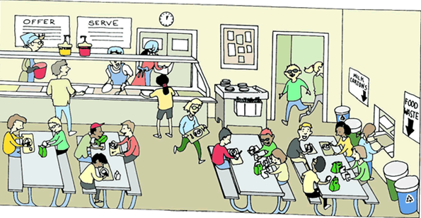
Words & Phrases
cafeteria n. [C] an informal restaurant in a place such as a college or hospital where you take the food to the table yourself 自助食堂；自助餐馆
e.g. the school cafeteria
学校食堂

Slide 60
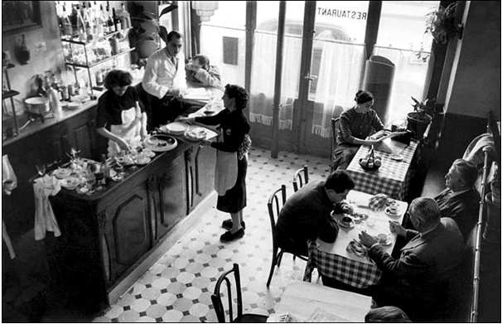
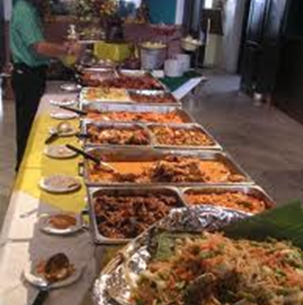

Words & Phrases
Cf.
café 咖啡馆；小餐馆
buffet 自助餐
internet café 网吧

Slide 61
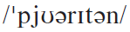
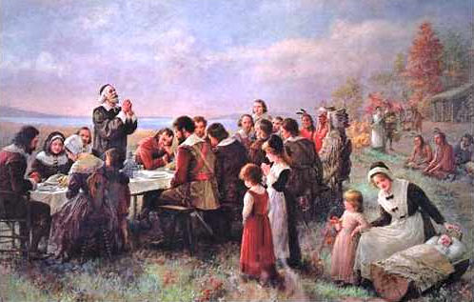
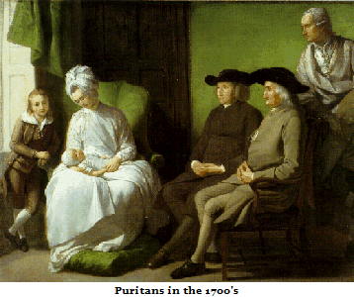
Words & Phrases
Puritan n. [C] a member of a strict English religious group of the 16th and 17th centuries who wanted worship to be more simple 清教徒（16世纪和17世纪之间主张简化礼拜活动的宗教团体成员）

Slide 62
Words & Phrases
Read the following introduction to Puritans and answer the questions.
Puritans was the name given in the 16th century to the more extreme Protestants (新教徒) within the Church of England who thought the English Reformation (宗教改革运动) had not gone far enough. They wanted to purify their church by eliminating Catholic (天主教的) influence.
Yes.
Was Puritans a branch of Protestants?

Slide 63
Words & Phrases
In the relation of churches to civil power (统治权), Puritans opposed the supremacy of the monarch in the church, and argued that the only head of the Church in heaven or earth is Christ. Puritans sought both individual and corporate conformity (一致) to the teaching of the Bible, with moral purity pursued both down to the smallest detail as well as spiritual purity to the highest level. They believed that man existed for the glory of God, that his first concern in life was to do God’s will and so to receive future happiness.
According to Puritans, should Emperor be the head of church?
Yes.
No.
Are Puritans strictly self-disciplined people?

Slide 64
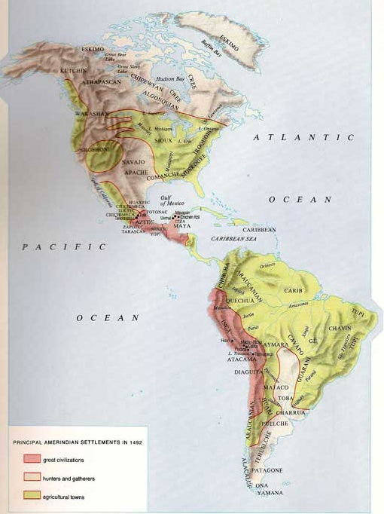
Words & Phrases
In the 17th century many Puritans emigrated (移民) to the New World and Puritanism remained the dominant cultural force in New England into the 19th century.
Where was the New World?
The continents of North and South America.

Slide 65
Words & Phrases
out of: how many of a group, used to say how common sth. is, or how large a part of a group you are talking about ……中的几个
e.g.
1. After all, they will have to use undo only two times out of ten instead of having to deal with a redundant dialog box eight times out of ten.
毕竟现在10次中只有2次需要使用撤销，而不是10次中不得不 需要8次处理多余的对话框。
2. He was chosen out of the class to take part in the contest.
他被从全班挑选出来参加竞赛。

Slide 66
Words & Phrases
in the long run: not immediately but at a time in the future 从长远来看；终究
e.g.
1. In the long run these hormones can have a harmful effect on the body and brain. (CET4-2005-12)
这些激素终究会对身体和大脑产生不良影响。
2. It may come out better than you think in the long run.
从长远看，也许结果比你所想的要好。
Antonym: in the short run 从短期来看；不久
Cf. in the long / short term 就长期 / 短期而言

Slide 67
Words & Phrases
be / feel lost: to not feel confident about what to do or how to behave 迷惘；困惑；不知所措
e.g.
1. It’s not unusual to feel rather lost when you first start college.
刚上大学时感到很迷惘，这非常正常。
2. James was at a loss as to what to do and felt lost.
詹姆斯无所适从，惘然若失。

Slide 68
Words & Phrases
frighten the life out of sb. / frighten sb. to death: (infml) make sb. feel extremely afraid or nervous 把某人吓得没命 / 使某人紧张得要死
Also: frighten sb. out of their wits
Translate the following Chinese into English.
1. 那孩子让狂风暴雨吓得要命。
The child was frightened to death by the violent thunderstorm.
2. 以后再也不要带我去看恐怖电影了，我简直连魂都吓掉了。
Never take me to watch horror films again. I was almost scared out of my wits.

Slide 69
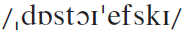
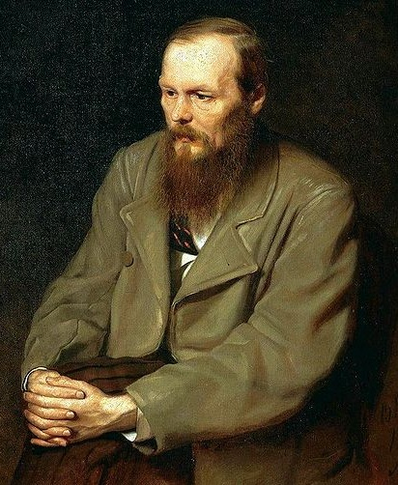


Words & Phrases
Dostoyevsky 陀思妥耶夫斯基
Feodor Dostoyevsky (1821–1881) was an outstanding 19th-century Russian novelist. His most famous novels are Crime and Punishment (《罪与罚》) and The Idiot (《白痴》). His works also include The Brothers Karamazov (《卡拉马佐夫兄弟》) and The Gambler (《赌徒》). He is sometimes credited as the creator of the modern psychological novel.

Slide 70
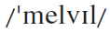
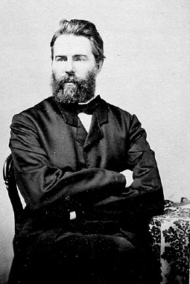

Words & Phrases
Melville 梅尔维尔
Herman Melville (1819–1891) was an American writer who wrote a long novel called Moby Dick (Moby Dick is the name of a white whale). He also wrote short stories and poetry. Moby Dick (1851) is an adventure about hunting whales, and has been made into several films.

Slide 71

Words & Phrases
NYU New York University 纽约大学
Founded in 1831, New York University is now one of the largest private, nonprofit institution of higher education in the United States. NYU is organized into 18 schools, colleges, and institutes. Although overall the University is large, the individuals schools and colleges are small- to moderate-sized units. The students come from every state in the country and from 133 foreign countries. With more than 2,500 courses offered, the University awards more than 25 different degrees.
As a large city, New York has many universities and smaller colleges, including the State University of New York (SUNY) and the City University of New York (CUNY).

Slide 72
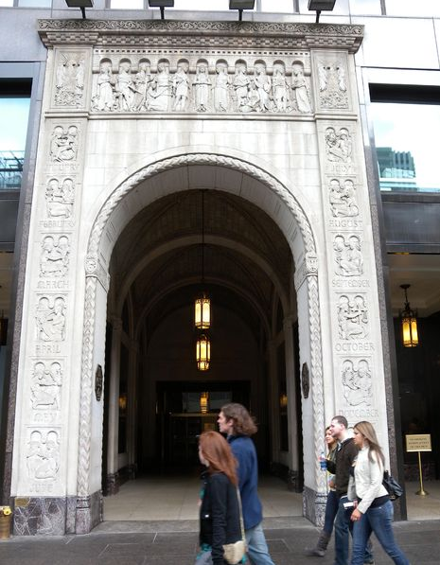
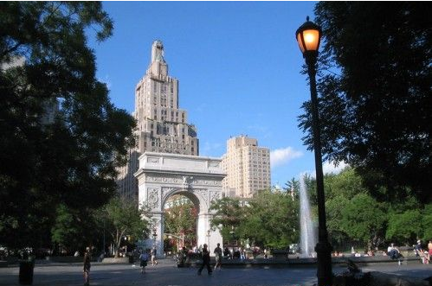
Words & Phrases

Slide 73
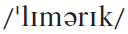
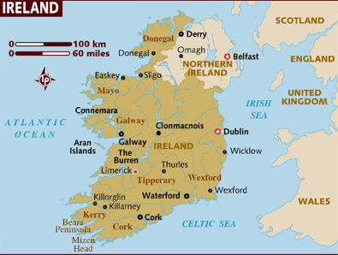
Words & Phrases
Limerick: a port city in western Ireland 利默里克（爱尔兰西部城市）
Limerick

Slide 74
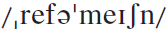
Words & Phrases
the Reformation （欧洲16世纪的）宗教改革
The Reformation refers to a period of religious change in Europe in the 16th century, when the Protestant Church was started. During the Reformation, efforts to reform religious practices and beliefs resulted in the development of a variety of new churches with differing ideas about individualism and authority, broadly still called Protestant churches. This was followed by the Counter-Reformation, during which the Catholic Church made efforts to change, reform and defend itself. Both Protestants and Catholics are Christians, of course, but in the past they have fought violent wars against each other, and even today there is violence in Northern Ireland which is in part based on religious differences.

Slide 75
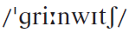
Words & Phrases
Greenwich Village 格林尼治村（美国纽约市曼哈顿区的一部分，艺术家、作家等的聚居地）
Greenwich Village is an area of New York City that was especially fashionable in the 1960s. The area was famous for avant-garde writers, poets, artists and film-makers.
The center of NYU is its Washington Square campus in the heart of Greenwich Village. One of the city’s most creative and energetic communities, the Village is a historic neighbourhood that has attracted generations of writers, musicians, artists, and intellectuals. NYU, in keeping with its founder’s vision, is “in and of the city”: the University – which has no walls and no gates – is deeply intertwined with New York City, drawing inspiration from its vitality.

Slide 76
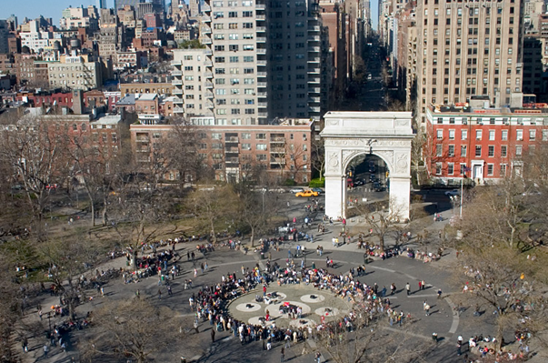
Words & Phrases
Washington Square Campus

Slide 77
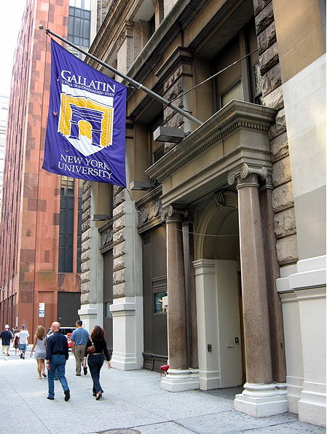
Words & Phrases
Flags identify NYU buildings in the city.

Slide 78


Language Points
Since I’m not a high school graduate and work full time …
The writer has never studied in a high school, and now he’s a full-time worker.
翻译：
由于我不是高中毕业生，而且有一份全职工作……

Slide 79
Language Points
I don’t know why I have to be introduced to literature but the woman in the admissions office says it’s a requirement even though I’ve read Dostoyevsky and Melville and that’s admirable for someone without a high school education.
The writer resents having to take the Introduction to Literature course because he believes that he has read widely, and knows literature already. He gives Dostoyevsky and Melville as examples because their novels are long and complex. The woman is following the rule that “it’s a requirement”, and she is condescending when she says it’s “admirable”, because she reminds him of his lack of formal education.

Slide 80
Language Points
I don’t know why I have to be introduced to literature but the woman in the admissions office says it’s a requirement even though I’ve read Dostoyevsky and Melville and that’s admirable for someone without a high school education.
翻译：
我不知道为什么我非得了解文学。可是招生办公室的那位女士说，虽然我读过陀思妥耶夫斯基和梅尔维尔的小说，虽然一个没上过高中的人能读这些书的确令人敬佩，但这门课是必修课。

Slide 81
Language Points
Cf.
even though 虽说，表示实际上已经发生的事实
even if 即使，表示未知情况或与事实相反的假设
Paraphrase the following sentences.
1. Even if he knows it, he’ll not let out the secret.
Whether he knows the secret or not is not sure.
2. Even though I have tried many different ways, I still can’t fix the problem.
I did try many ways.
3. Even if she had been a little late, we still would have waited for her.
She was not late.
4. Even though I have enough money, I won’t buy this luxurious car.
I do have enough money.

Slide 82
Language Points
She says The History of Education in America course will provide me with the broad cultural background I need after my inadequate European education.
The woman means what the writer has learnt previously is not enough to deal with the life in the US. He will certainly know more about the American culture in the course. We can feel the writer’s sense of humour upon his own poor education and the woman’s vague superiority.
翻译：
她说由于我接受的欧洲教育不全面，“美国教育史”能使我具备广博的文化背景知识。

Slide 83
Language Points
I’m in heaven and …
I’m in heaven: The expression implies that the writer is overjoyed because he has now registered as a student and is ready to start classes.
翻译：
我乐得飘飘然了……

Slide 84

Language Points
… cover them with the purple and white NYU book jackets so that people in the subway will look at me admiringly.
The writer does not mean to be admired by people in the subway. It’s a humorous way to show the superiority of being a NYU student and the writer’s happiness.
翻译：
……用纽约大学紫白相间的护封把它们套起来，这样地铁里的乘客就会向我投来艳羡的目光了。
book jacket
书衣

Slide 85
Language Points
All I know of university classes is what I saw a long time ago in the movies in Limerick and here I am sitting in one …
The writer’s only knowledge about university classes comes from the movies he watched in Ireland many years ago, but now he is sitting in a university classroom, having a class.
翻译：
我对大学课堂的了解全部来自很久以前我在利默里克看的那些电影，我现在就坐在大学课堂里听一门课……

Slide 86
Language Points
All around me are students scribbling away in their notebooks and I wish I knew what to scribble myself.
This sentence is in its inverted order, the normal order should be: Students are scribbling away in their notebooks all around me.
If the prepositional phrase of the adverbial of time, place or location is put at the beginning of a sentence, the sentence should be in its inverted order.
翻译：
我周围的同学全都在不停地记笔记。我真希望自己也知道记点儿什么。

Slide 87
Language Points
e.g.
1. Then begins the meeting.
之后会议开始了。
2. Under the road run pipes for gas and water.
在马路下面铺着煤气管道和自来水管。
3. Down jumped the burglar from the tenth floor when the policeman pointed a pistol at him.
当警察用枪对准强盗时，他从十层跳了下来。

Slide 88
Language Points
How am I supposed to know what’s important out of all the things she’s saying up there?
This is a rhetorical question, implying that the writer finds it impossible to decide which things are important enough to note down.
be supposed to do sth.: be generally expected or considered to have a particular quality or skill 应该是；应该有
e.g. This restaurant is supposed to make excellent salads.
人们普遍认为这家餐馆做的沙拉味道极好。
翻译：
我怎么知道她在讲台上说的哪些话是重要的呢？

Slide 89
Language Points
Some students raise their hands to ask questions but I could never do that … When I try it people always smile and say, Do I detect an Irish brogue?
Do I detect an Irish brogue?
Here “I” refers to someone around him in the class. The question is other people’s possible response when they hear the writer speak English. As this is a piece of informal writing, the writer omits the quotation marks. A similar case is “Well, I think.” in Paragraph 5.

Slide 90
Language Points
Do I detect …? 是一个口语常用句型，汉语一般不需要将Do I detect直译出来。比如本句可译为“好像有爱尔兰口音？”，而不宜译为“我发现了爱尔兰口音？”。
e.g.
1. Do I detect a note of criticism?
好像带有批评的口吻吧？
2. Do I detect a note of irony in your voice?
听起来你是在说反话吧？
3. Do I detect a touch of jealousy in that remark?
听起来那话里有点儿妒忌之意吧？

Slide 91
Language Points
Some students raise their hands to ask questions but I could never do that … When I try it people always smile and say, Do I detect an Irish brogue?
The writer feels uncomfortable in a foreign country. He is conscious of his foreign accent and afraid of speaking in the class. He ever imitated the American accent, but others always find him out. When others notice his Irish accent, he is really embarrassed. These sentences show the writer did not have a sense of belonging at the beginning of his American life.
翻译：
有些同学举手问问题，可我永远不能那么做……我试着用美音说话时，人们总是微笑着说，是不是听到爱尔兰土腔了？

Slide 92
Language Points
(From the interview with Frank McCourt)
“The minute I opened my mouth then they’d say, ‘Oh, you’re Irish.’ Suddenly I’m labeled. I wasn’t a human being. In Ireland I was just a low-class type, but here I’m a low-class Irish type, an Irish low-class type. So I didn’t know. Somehow I had to deal with that. ‘Oh, you’re Irish.’ And at that time, that was 1949, there was still some kind of a lingering residue (残余) of prejudice against the Irish. People used to tell me, all the people, up and down New England (I’m in New York), there would be signs saying, ‘No Irish need apply (爱尔兰人不得申请).’”

Slide 93
Language Points
“And even the Irish-Americans would listen to me and they’d patronize (对……以恩人自居) me. I was a bit simple as if I had just come off a farm. And I knew better than that. I knew I was better than that. People who – Irish-Americans who were running elevators and working as porters, they were looking down on me, and I knew then that I was again at the bottom of the heap.”

Slide 94
Language Points
Anti-Irish sentiment is traditionally rooted in the medieval period Irish and English relationship and is also evidenced in Irish immigration to other countries like the United States. In the 1860’s nearly one half of all immigrants to the United States were Irish. Discrimination and prejudice against the Irish was common, especially if they were Catholic. Irish Catholics in America have a memory of job discrimination, which featured signs proclaiming “Help Wanted – No Irish Need Apply!” Some Americans feared the Irish because of their religion, their use of violence, and their threat to democratic elections.

Slide 95


Language Points

Slide 96
Language Points
… and that puzzles me because the Pilgrims were English themselves and the English were always the ones who persecuted everyone else, especially the Irish.
As an Irishman, the writer obviously disagrees with what the professor says, although it’s true that the Pilgrims left England for political and religious freedom. It is unacceptable for him to talk about the English being persecuted since they, as a nation, has always been invading and colonizing other nations, especially their neighbour Ireland.
翻译：
……这让我大惑不解，因为清教徒本身就是英国人，而英国人总是到处迫害别人，尤其是爱尔兰人。

Slide 97
Language Points
About the relationship between England and Ireland
The English colonized Ireland in the 12th century and for almost 800 years oppressed (压迫) the people through force. They tried to eradicate (根除) the religion, language, culture and traditions of the Irish and even the Irish people themselves. They disposed the Irish from their lands, handing them over to British settlers through a number of plantations (种植园), which is why there are many people of British descent and protestant faith (the native Irish being predominantly catholic) in Northern Ireland today.

Slide 98
Language Points
Throughout the 800 years of British rule, native Irish people were beaten, murdered and sold into slavery by the British who considered them a subspecies. This led to a great deal of hatred on the part of the Irish people. It was not until the war of independence that the Irish regained control of most of their homeland. However, the Anglo-Irish treaty that gave Ireland independence did so on the condition that the six counties of what was to become Northern Ireland were to remain under British rule with the remaining 26 counties to become the independent nation of the Republic of Ireland.

Slide 99
Language Points
… but I’m sure everyone in this class has a high school diploma and if I open my mouth they’ll know I’m not one of them.
Even though the writer has different ideas, he is not ready to express himself in front of others, since, on the one hand, he is the least-educated one in the class, on the other hand, he is afraid of being discovered an Irishman.
翻译：
……但我知道班上的每个人都有高中文凭，只要我一开口，他们就会知道我和他们不一样。

Slide 100
Language Points
Some day I’ll raise my hand and say, Well, I think, but I don’t know what to think about Pilgrims and their education.
The writer believes he will improve himself and speak bravely and naturally in front of the class, nevertheless, he still disagrees with what the professor teaches about the Pilgrims, that is, he is always ideologically different from the Americans.
翻译：
总有一天我也会举手发言，说：嗯，我认为……可对清教徒和他们的教育问题，我还真不知道该如何认为。

Slide 101
Language Points
Then the professor tells us ideas don’t drop fully formed from the skies …
This means that ideas have precedents and a history. They don’t come from nothing, but are born in the context of previous ideas.
翻译：
接着，教授告诉我们，观念并不是从天而降的现成品……

Slide 102
Language Points
… that the Pilgrims were, in the long run, children of the Reformation with an accompanying world view and their attitudes to children were so informed.
Children of the Reformation refers to the Pilgrims who went to America and who had inherited ideas from the Reformation. Their world view included ideas about religious freedom (the right to worship in their own way), independence and individualism, economic and political freedom, and the importance of education for children.
翻译：
（清教徒是）宗教改革运动的产物

Slide 103
Language Points
… that the Pilgrims were, in the long run, children of the Reformation with an accompanying world view and their attitudes to children were so informed.
Seen in the long run, the Pilgrims were the children (products) of the religious movement of the Reformation. They inherited the Reformation’s world view, and their attitudes to children were based on and influenced by such a view. Here the professor is reminding the class that the historical and cultural context is important.
So is grammatical substitution here, meaning “affected by the Reformation and the world view of the time”.

Slide 104
Language Points
… that the Pilgrims were, in the long run, children of the Reformation with an accompanying world view and their attitudes to children were so informed.
翻译：
从长远来看，清教徒是宗教改革运动的产物，他们继承了宗教改革运动的世界观，并且他们对孩子的态度也由此体现了宗教改革运动的思想。

Slide 105

Exercises
Reading and understanding
Dealing with unfamiliar words
Reading and interpreting
Developing critical thinking

Slide 106
Exercises
Reading and understanding
3 Answer the questions.
1 Why doesn’t the writer think he needs to be introduced to literature?
2 How does the writer feel as he listens to Professor Green’s lecture?
3 Why does the writer want to try an American accent?
4 Does the writer agree with the professor about the Pilgrims? Can you explain why or why not?
5 How does the writer feel about his chances of success as a student?

Slide 107
Exercises
1 Why doesn’t the writer think he needs to be introduced to literature?
Because he’s even read Dostoyevsky (a Russian novelist) and Melville (an American writer) whose novels are lengthy and hard for students.
2 How does the writer feel as he listens to Professor Green’s lecture?
He feels uncertain. He lacks confidence and seems insecure. He doesn’t know what kind of notes to write or what he’s supposed to remember.

Slide 108
Exercises
3 Why does the writer want to try an American accent?
So that he can sound like the other students, like Americans.
4 Does the writer agree with the professor about the Pilgrims? Can you explain why or why not?
No, not really. The writer is puzzled because he has a different view based on Irish history. His view is that the English persecuted the Irish and other people, so he wonders why the English would escape from persecution. He wants to tell the professor about the Irish suffering.

Slide 109
Exercises
5 How does the writer feel about his chances of success as a student?
He’s not confident at the moment about his success. He’s worried about the exams because he doesn’t know where the questions will come from. The professor talks a lot and the textbook is thick – there seems to be too much to learn.

Slide 110
Exercises
Dealing with unfamiliar words
4 Replace the underlined words with the correct form of the words below.
5 Answer the questions about the expressions.

Slide 111
Exercises
4 Replace the underlined words with the correct form of the words below.
admirable detect inadequate persecution
scribble subway
1 When he speaks, people notice that he sounds Irish.
2 Frank McCourt had read a lot of books, which was deserving of respect considering he had no high school education.
3 You can tell the students on the underground trains by the books they carry.
detect
admirable
subway

Slide 112
Exercises
admirable detect inadequate persecution
scribble subway
4 The woman in the admissions office suggests that his European education is not good enough.
5 The professor was writing very quickly in his notebook.
6 Many immigrants came to America to escape extremely bad treatment because of their race, religion or political beliefs in their own countries.
inadequate
scribbling
persecution

Slide 113
Exercises
5 Answer the questions about the expressions.
1 I’m in heaven Does this mean I’m (a) delighted, or (b) unhappy?
2 ideas don’t drop fully formed from the skies Does this mean that ideas (a) need to be developed with careful thinking, or (b) are immediately created through good teaching?
3 in the long run Does this mean (a) at a time in the future, or (b) with a great deal of effort?
4 frighten the life out of someone Does this mean (a) to make someone very ill, or (b) to make someone extremely afraid and nervous?
5 Answer the questions about the expressions.
1 I’m in heaven Does this mean I’m (a) delighted, or (b) unhappy?
2 ideas don’t drop fully formed from the skies Does this mean that ideas (a) need to be developed with careful thinking, or (b) are immediately created through good teaching?
3 in the long run Does this mean (a) at a time in the future, or (b) with a great deal of effort?
4 frighten the life out of someone Does this mean (a) to make someone very ill, or (b) to make someone extremely afraid and nervous?

Slide 114
Exercises
Reading and interpreting
6 Work in pairs. Look at the sentences from the extract and answer the questions.
1 She says The History of Education in America course will provide me with the broad cultural background I need after my inadequate European education.
How does the writer feel about his European education being described as inadequate?

Slide 115
Exercises
Reading and interpreting
The writer may be exaggerating. Perhaps the woman in the admissions office did not actually say that his education was “inadequate”, but she made him feel like this.
The woman may have a point. If all the American students have a high school diploma and the writer doesn’t have one, then he is not qualified in the expected way (and might be considered lucky to have this chance of university education).

Slide 116
Exercises
2 All around me are students scribbling away in their notebooks and I wish I knew what to scribble myself. How am I supposed to know what’s important out of all the things she’s saying up there?
How does he feel about being in class at the moment?
He is not sure what to write and what sort of notes to take. He has no experience of note-taking, and feels puzzled as no one has given him any guidance.

Slide 117
Exercises
3 Some students raise their hands to ask questions but I could never do that. The whole class would stare at me and wonder who’s the one with the accent.
Does he feel part of the class yet?
No, he feels different because of his accent and background.

Slide 118
Exercises
4 I’d like to raise my hand and tell the professor how the Irish suffered for centuries under English rule but I’m sure everyone in this class has a high school diploma and if I open my mouth they’ll know I’m not one of them.
What does this sentence reveal about the writer’s self-confidence?
It reveals that the writer lacks self-confidence. Despite wanting to share something important with the class, he worries that his accent will mark him as an outsider.

Slide 119
Exercises
5 I could tell the girl how I read Dostoyevsky and Melville and she’d be impressed and fall in love with me and we’d study the history of education in America together.
Do you think he has made friends yet? How does he feel about this?
It seems he has not made friends yet. He’s dreaming (or fantasizing) about a romance.
• He must feel like a stranger, a bit lonely.
• He’d like to share what he knows with someone, but he
feels he can’t do this in class.

Slide 120
Exercises
Developing critical thinking
7 Work in pairs and discuss the questions.
1 The writer is overwhelmed by his teachers and the other students, and fears he’s not good enough. How common is this experience in a Chinese university?
2 Is it acceptable to question professors whose views you don’t agree with?
3 Are there some other experiences that you think are equally important in university as learning from your professors?

Slide 121
Exercises
1 The writer is overwhelmed by his teachers and the other students, and fears he’s not good enough. How common is this experience in a Chinese university?
This phenomenon is very common in Chinese universities. Our tutors have high expectations of us, and the fear of not being able to keep up with our peers is a source of almost overwhelming pressure. University is very competitive, and excellent students are everywhere. We all worry that if we are not good enough, we will fall behind the other students.

Slide 122
Exercises
2 Is it acceptable to question professors whose views you don’t agree with?
• Some students think that it is important to question professors, provided that you are polite and have reasons to back up your opinion. A valuable part of university education is learning to think critically, so some professors welcome this form of discussion.
• Other students think that professors know best and should not be questioned unless they have clearly made a mistake. After all, professors are highly educated and very knowledgeable in their fields, and that’s why we choose to learn from them.

Slide 123
Exercises
3 Are there some other experiences that you think are equally important in university as learning from your professors?
• It’s equally important to be independent and to learn to think for yourself to prepare you for work and life.
• It’s very important to get on with people and learn to work as part of a team. Every adult should learn how to do this. Improving IT and communication skills is also important.

Slide 124

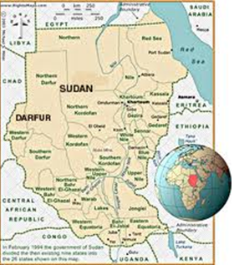
Extension Activities
School for Ex-Soldiers
Before listening to the programme, familiarize yourself with the following words.
Sudan
refugee
Darfur
Santo Khamis
messenger
donation
苏丹，非洲国家
难民
达尔福尔（苏丹西部一地区）
人名
送信者
捐赠

Slide 125
Extension Activities
Listen to the programme and answer the following questions.
1. What does William think of Sudan?
The country Sudan reminds him of not very positive stories, for example, stories about the war and about refugees in Darfur.
2. Why is the school very special?
It’s a school for ex-child soldiers.

Slide 126
Extension Activities
3. Explain the two words, aggressive and stubborn, in English.
Someone who is described as “aggressive” behaves in an angry and forceful way – and a way that makes other people feel threatened, uncomfortable, maybe even afraid sometimes.
Someone who is described as “stubborn”, continues to do or to believe exactly what they want, even if they’re wrong. So a stubborn person can be really annoying and difficult to deal with because they refuse to change their mind.

Slide 127

Extension Activities
4. How long does it usually take before students change for the better?
It only takes about a year.
5. Say something about the students’ future.
Learning helps them to get jobs. With lots of donations and more volunteers, they can start the secondary schools and even go to universities.

Slide 128
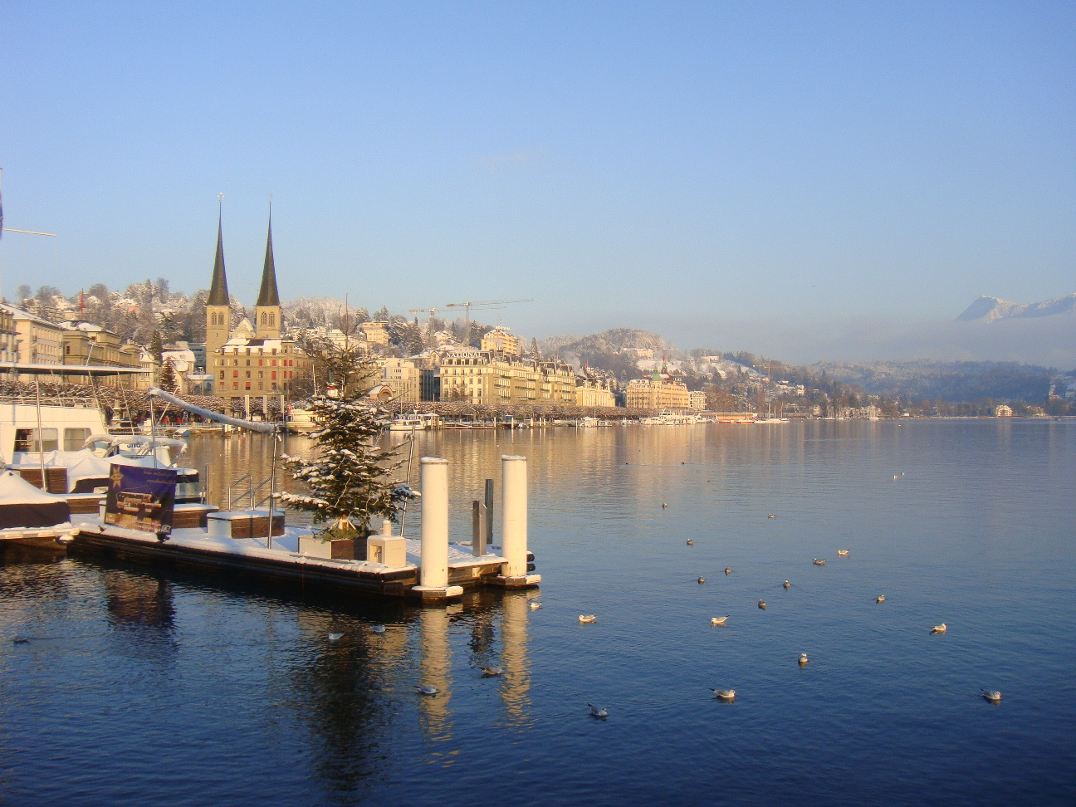

Thank you

